Slide 1
MLB Pitch Data Analysis : Project 1
Michael Parham, Tim Jung, Andrew Corona, Aaron Windmiller

Slide 2
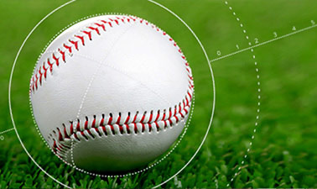
MLB Pitch Data:
An examination of MLB pitch data and correlating factors affecting outcome
Major league baseball is a historically rich source of comprehensive data due in large part to the situational matchups that regularly occur in games. Historians and statisticians have done a tremendous job curating these data over the years, providing the public with widely available information
Significant improvements in the sophistication levels of MLB statistical analysis occurred throughout the 1970’s with the advent of Sabermetrics (Society for American Baseball Research, est. 1971). These advances in statistical analysis reached a point of inflection with the successful 2001 Oakland A’s season due to their embrace of Sabermetrics. The season was immortalized with the 2003 book, Moneyball (and Oscar nominated 2011 movie of the same name).

Slide 3
MLB Pitch Data:
An examination of MLB pitch data and correlating factors affecting outcome
Process:
We were able to find our data on Kaggle. The original source was mlb.com. The most useful and comprehensive was pitch data from 2015-2018. Rows were pitches and we had 2.87 million rows to manipulate (the csv was 766MB which gave us some challenges initially).
The pitches file was merged with others like: “player names”, “at bats” and “games” and scrubbed of extraneous or missing values.

Slide 4
MLB Pitch Data:
An examination of MLB pitch data and correlating factors affecting outcome
Our team was hoping to identify some correlations affecting the result of pitches thrown:
Initially, we thought weather may play a large role in determining pitch result but found that we needed to be more specific with our hypothesis
‘Pitch result’ needed further clarification:
Is pitch velocity the result of a pitch or is the outcome the result?
Should we be measuring velocity as it crosses the plate or when it leaves the pitchers hand?
What data should be omitted?:
Should games in a climate controlled setting be included?
Given the smaller sample size of temperature extremes, how should we determine the relevance of correlations at those temperatures
We later expanded to the scope of the research to include various other relationships including:
Velocity by Month
Break Angles by Pitch Type
Pitch Type count by Month
Etc.

Slide 5
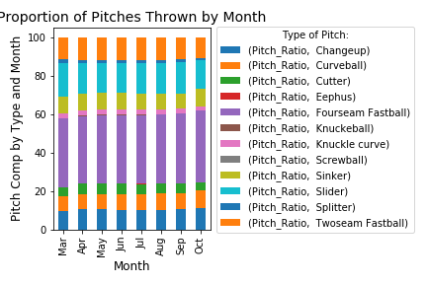
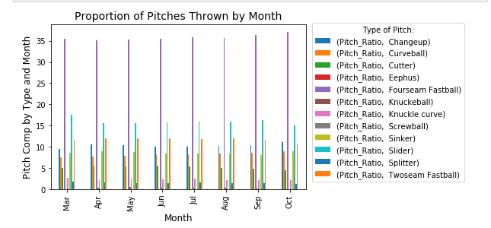
MLB Pitch Data:
An examination of MLB pitch data and correlating factors affecting outcome
One of the first things we looked at was the type of pitches thrown and if it varies by month.
It was immediately apparent that fourseam fastballs were by far and away the most prevalent pitch in baseball
After fourseam fastballs, sliders and curveballs were common
It also appears that the frequency of fourseam fastballs increase as the season progresses, perhaps indicating that pitchers fall back on the familiar as they tire throughout the season

Slide 6
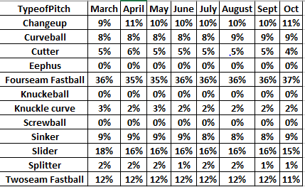
MLB Pitch Data
Pitches by Month
This table shows that the percentage of types of pitches by month is largely consistent, with a few exceptions
Usage of sliders decreased over the course of the season
Usage of curveballs increased over the course of the season
Usage of Knuckle curves declined as the season went on
The majority of pitches by percent were “Fourseam Fastball”

Slide 7
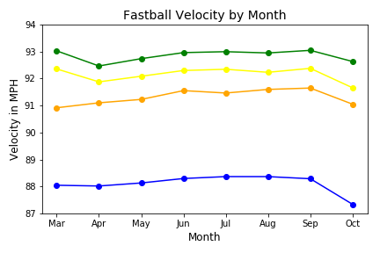
MLB Pitch Data:
An examination of MLB pitch data and correlating factors affecting outcome
Building on the thought that perhaps pitchers tire throughout the season, we plotted fastball velocity by month
After looking at the graph, it appears that pitchers start at a high rate of speed and then slightly drop off only to regain the velocity by the end of the year. Ultimately culminating in another precipitous dropoff in October – playoff time for MLB
Drawing conclusions were challenging for this graph as the temperature varies throughout the year and the velocity could be a function of the ambient temperature or how fresh/rested they were

Slide 8
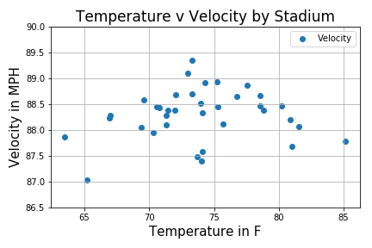
MLB Pitch Data:
An examination of MLB pitch data and correlating factors affecting outcome
Another interesting observance was the variance in average temperature by stadium
Pitch velocity seems to be higher between 70-80F

Slide 9
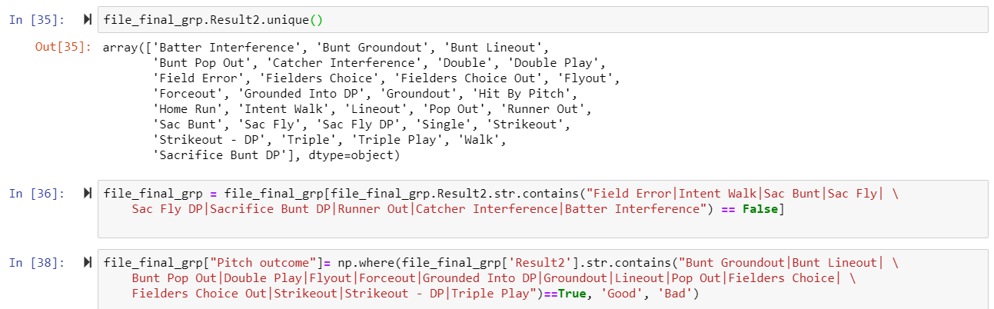
MLB Pitch Data:
An examination of MLB pitch data and correlating factors affecting outcome
Reclassifying the Outcome or Result became another interesting variable. Is outcome the velocity of the pitch? Perhaps. But fast pitches can also end up with a poor result for the pitcher. When looking through the lens of whether or not the pitcher was successful in the matchup with the batter, the findings changed.
This information was found by looking at the “Result2” category in the data. There were 30 separate fields with results ranging from Home Run to Intentional Walk and everything in between. The irrelevant fields were dropped and the remaining were recategorized as ‘good’ or ‘bad’ outcome

Slide 10
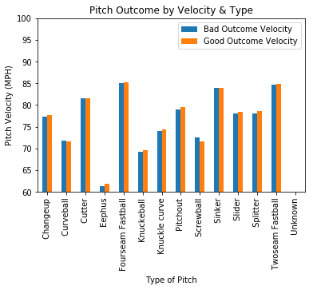
MLB Pitch Data:
An examination of MLB pitch data and correlating factors affecting outcome
When the data for true outcome was available, this could be plotted out for analysis
The first apparent correlation was that generally, from the pitcher’s perspective, increased velocity translates to a higher likelihood of success (however small). The only two exceptions were: Curveballs and Screwballs (basically reverse curveballs)
FIND CORRELATION and include

Slide 11

MLB Pitch Data:
Break Angle vs Velocity
One correlation that we found to be nearly statically significant was the relationship between Break Angle and Velocity
This yielded a r coefficient of nearly 0.6
Thereby indicating that the larger the Break angle, the higher the Velocity

Slide 12
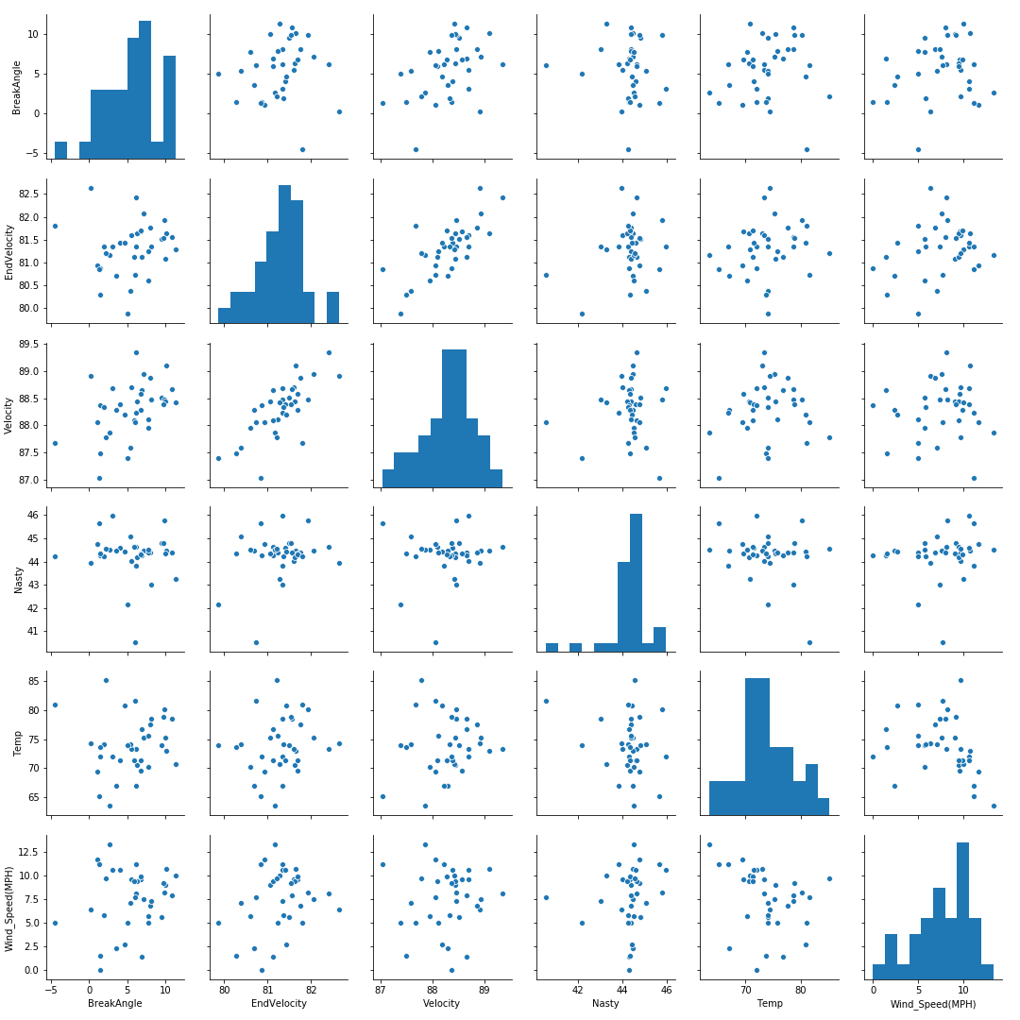
MLB Pitch Data:
An examination of MLB pitch data and correlating factors affecting outcome
This Seaborn plot demonstrates the distribution of pitches and their measurements extrapolated from our date frame
Some facets are approaching normal distribution

Slide 13
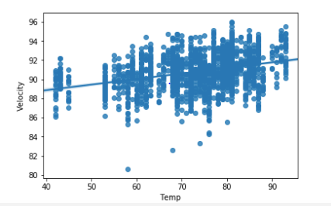
MLB Pitch Data:
Temperature vs Velocity
This graph shows that there is a slight upward trend between temperature and velocity
The hotter the weather gets, the faster the balls are thrown
This could be for a few reasons
Air is less dense when the weather is hotter
Muscles are looser when the weather is hotter

Slide 14

MLB Pitch Data
Nasty vs Velocity
Another facet that is approaching significance is Nasty vs Velocity
Nasty is a multi variable assessment of a pitch’s effectiveness
Effectiveness = lower chance of a batter hitting it well

Slide 15
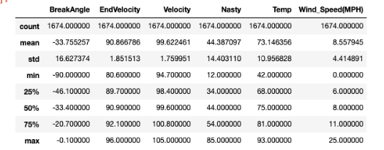
One correlation that we found to be nearly statically significant was the relationship between Break Angle and Velocity
This yielded a p-value of nearly 0.6
Thereby indicating that the larger the Break angle, the higher the Velocity
MLB Pitch Data:
Chapman as a case study

Slide 16
Final Observations
There is a slight correlation between temperature and velocity
However it is not very compelling
Other factors affect velocity include spin, type of pitch, and break angle
The “success of a pitch” is based on many factors other than velocity
Even though velocity of a pitch makes it harder to hit, it can also make it fly further if it is head – leading to home runs, doubles, and triples
We learned a lot about the importance of clean data and granularity
Otherwise you can make wrong assumptions, or follow flawed intuition
Individual pitchers can show strong correlations, to things such as temperatures
Chapman’s case study
Of course, these stats do not imply causality

